Slide 1

Project ON Movie Rental Store
BY
G S Kaushik
Under Guidance
DR AAKANSHA GUPTA

Slide 2
Introduction
MovieOnRent is a chain of movie rental stores operating in a certain country. It has a vast collection of movies in DVD and Blue Ray disc formats. The management of the company wants to analyze what kind of movies are most often rented, which genres they belong to, and which actors appeared in them. It will help the management stock up the inventory as per audience's preferences for improved business.
The objective of the project is to use MySQL to analyze the data of a movie rental store for further growth and improved business.

Slide 3

Content
Task 1 Pg1
Task 2 Pg2
Task 3 Pg3
Task 4 Pg4
Task 5 Pg5
Task 6 Pg6
Task 7 Pg7
Task 8 Pg8
Task 9 Pg9
Task 10 Pg10
Task 11 Pg11
Task 12 Pg12

Slide 4
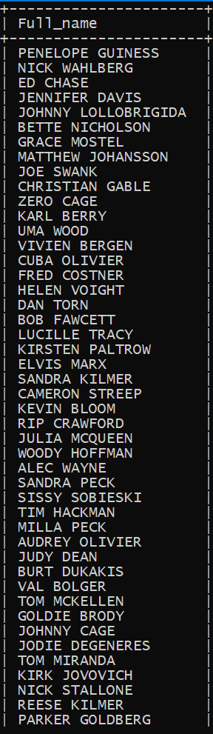
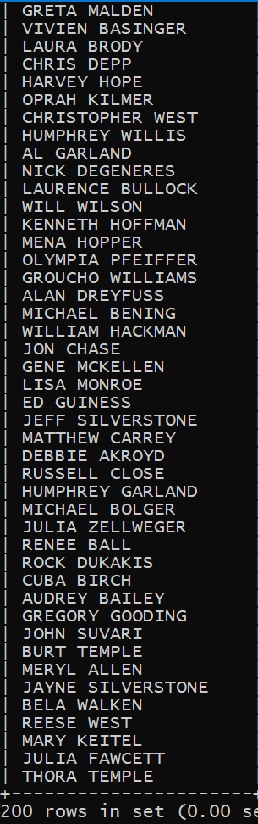
Task 1 Display Full names of actors available in the database.
Query :
select concat(first_name," ",last_name) Full_name from actor;
Conclusion :
There are 200 actors in the given database.

Slide 5
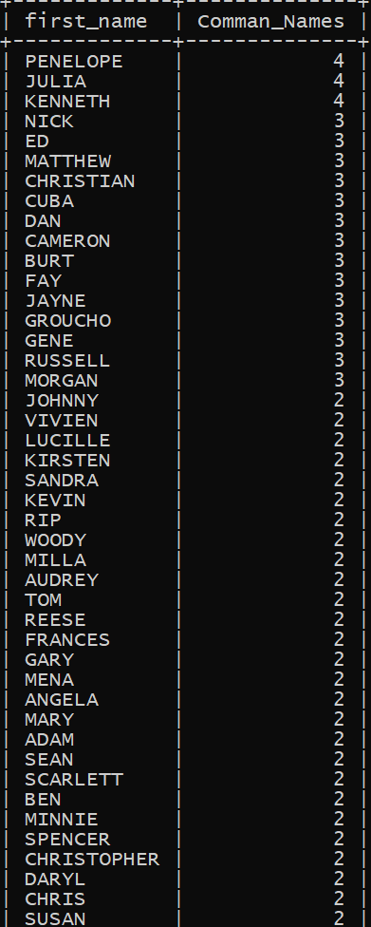
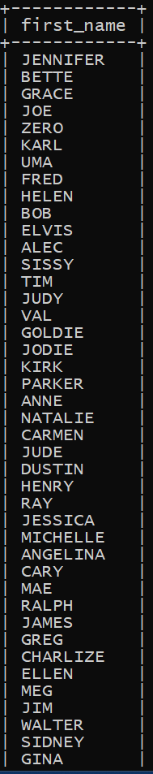
Task 2 Display the number of times each first name appears in the database. What is the count of actors that have unique first names in the database? Display the first names of all these actors.
Query :
select first_name , count(first_name) Comman_Names from actor group by first_name order by Comman_Names desc;
select first_name from actor group by first_name having count(first_name)=1;
Conclusion :
There are 4 actors whose name start with Penelope , Julia and Kenneth and it is the highest repeated names.
There are 76 Unique name of the actors.

Slide 6
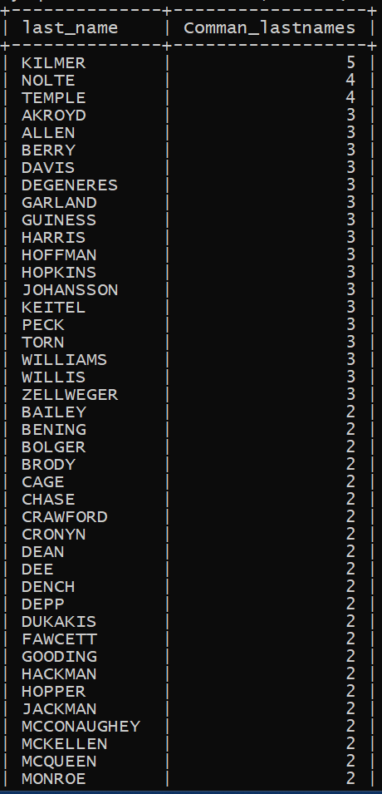
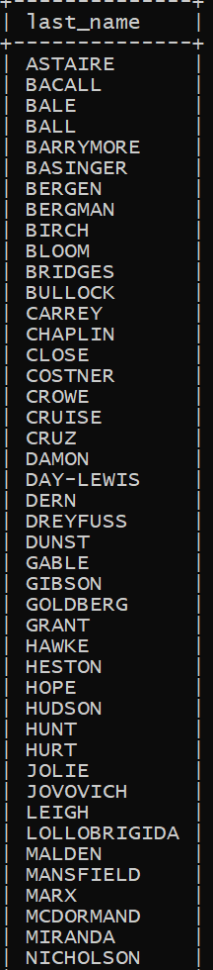
Task 3 Display the number of times each last name appears in the database. Display all unique last names in the database.
Query :
select last_name , count(last_name) Comman_lastnames from actor group by last_name order by Comman_lastnames desc;
select last_name from actor group by last_name having count(last_name)=1;
Conclusion :
There are 5 actors whose last name start with Kilmer and it is the highest repeated Last names.
There are 66 Unique Last name of the actors.

Slide 7
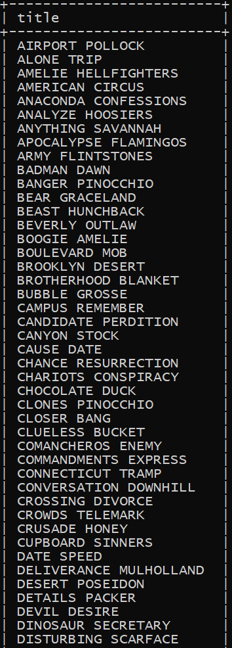
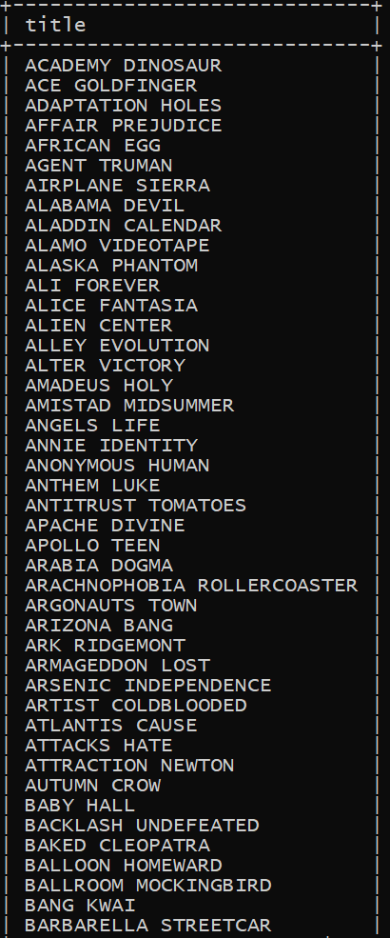
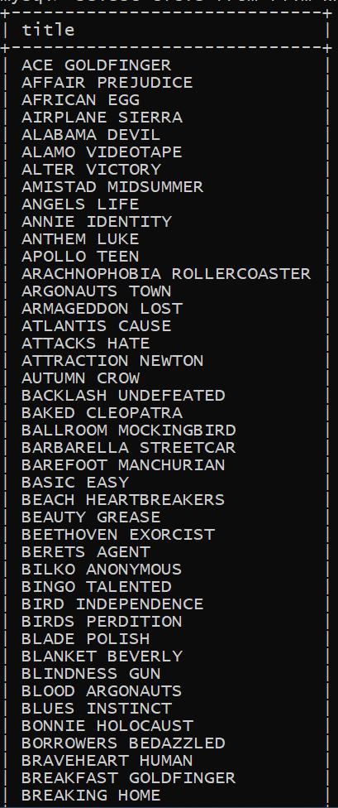
Task 4 Display the list of records for the movies with the rating "R". (The movies with the rating "R" are not suitable for audience under 17 years of age). Display the list of records for the movies that are not rated "R“. Display the list of records for the movies that are suitable for audience below 13 years of age.
Query :
select title from film where rating = 'R’;
select title from film where rating != 'R’;
select title from film where rating in ('PG-13','G') ;
Conclusion :
There are 195 movie in the R category
There are 805 movies that are not in R category
There are 401 movies that can be watched by children under age 13

Slide 8
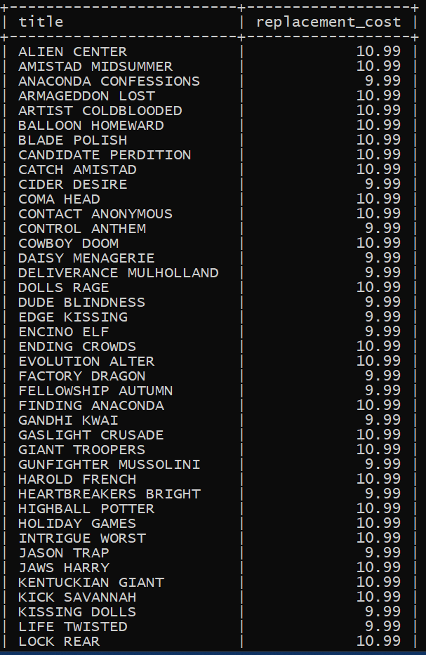
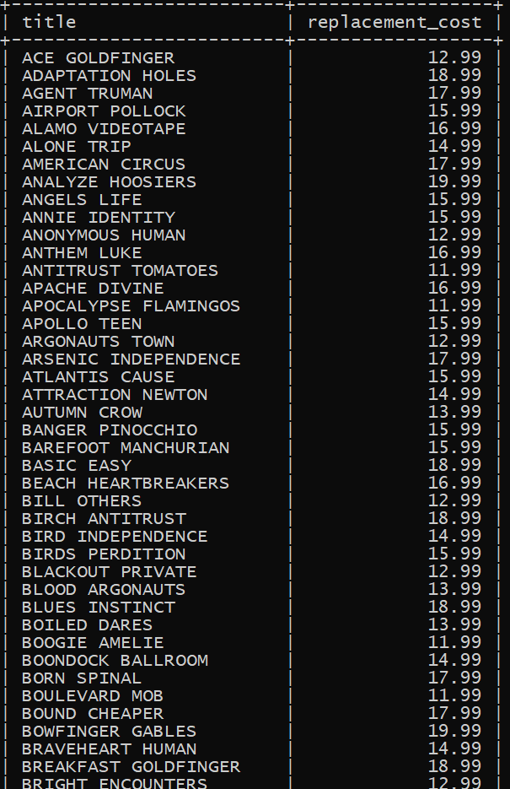
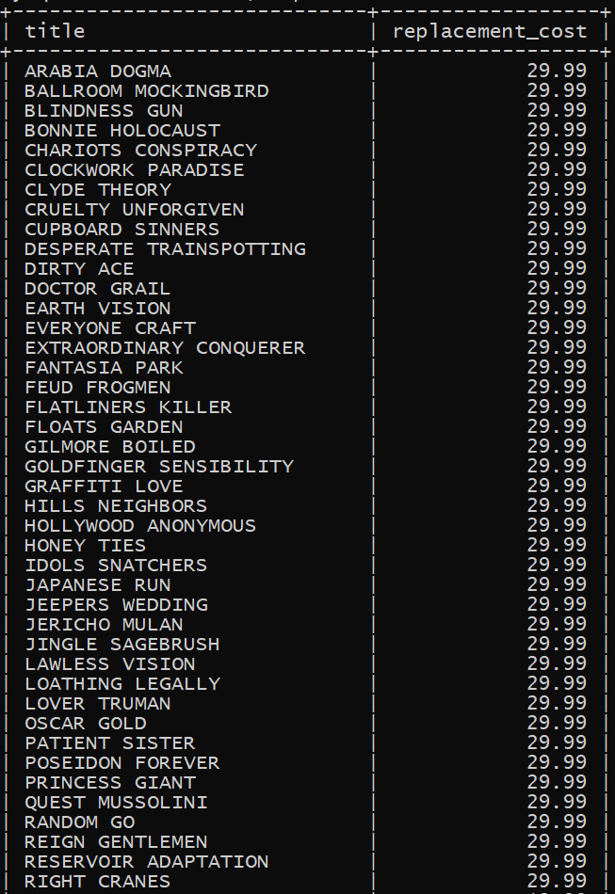
Task 5 Display the list of records for the movies where the replacement cost is up to $11. Display the list of records for the movies where the replacement cost is between $11 and $20. Display the list of records for the all movies in descending order of their replacement costs.
Query :
select title , replacement_cost from film where replacement_cost <= 11;
select title , replacement_cost from film where replacement_cost between 11 and 20;
select title , replacement_cost from film order by replacement_cost desc ;
Conclusion :
There are 90 movies whose replacement cost is less then or equal to 11
There are 424 movies whose replacement cost in between 11 to 20
Arabia dogma has the highest replacement cost.

Slide 9
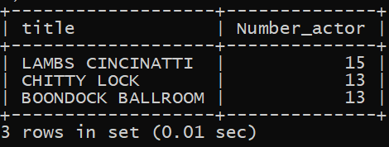
Task 6 Display the names of the top 3 movies with the greatest number of actors.
Query :
select title,count(actor_id) Number_actor from film f inner join film_actor fa on f.film_id=fa.film_id group by title order by Number_actor desc limit 3;
Conclusion :
Lambs Cincinnati has the highest number of actors

Slide 10
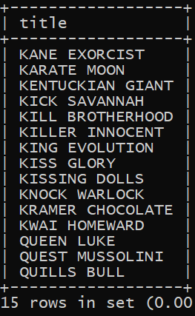
Task 7 'Music of Queen' and 'Kris Kristofferson' have seen an unlikely resurgence. As an unintended consequence, films starting with the letters K' and Q' have also soared in popularity. Display the titles of the movies starting with the letters 'K and Q’.
Query :
select title from film where title like 'K%' or title like 'Q%';
Conclusion :
There are 15 films whose name start with K and Q

Slide 11
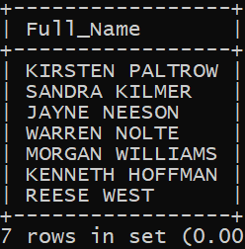
Task 8 Display the names of all actors who appeared in Agent Trueman film.
Query :
select concat(first_name," ",last_name) Full_Name from film f join film_actor fa on f.film_id=fa.film_id join actor a on a.actor_id=fa.actor_idwhere title like 'Agent Truman';
Conclusion :
There are 7 actors in the film Agent Trueman

Slide 12
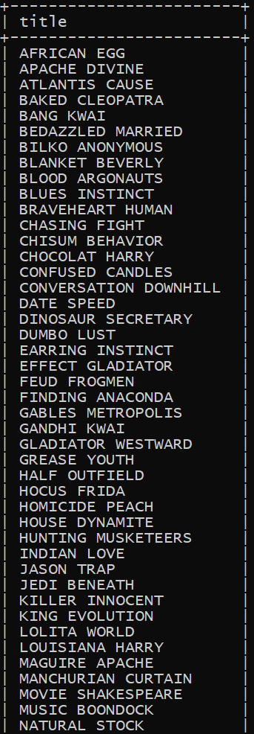
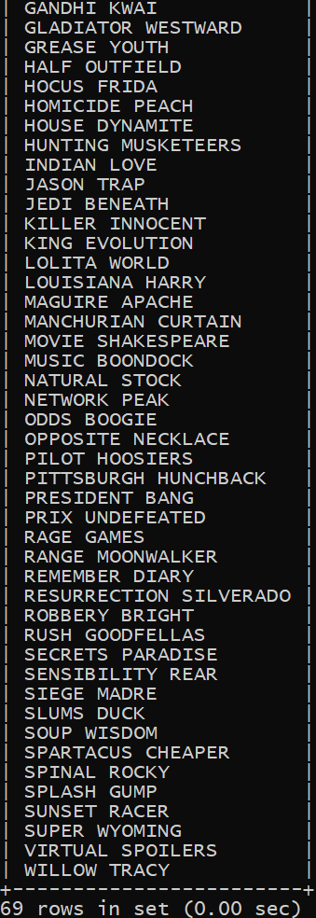
Task 9 Identify all the movies categorized as family films
Query :
select f.title from film f INNER join film_category fc on f.film_id = fc.film_id INNER join category c on fc.category_id = c.category_id where c.name = 'Family';
Conclusion :
There are 69 films in family category

Slide 13
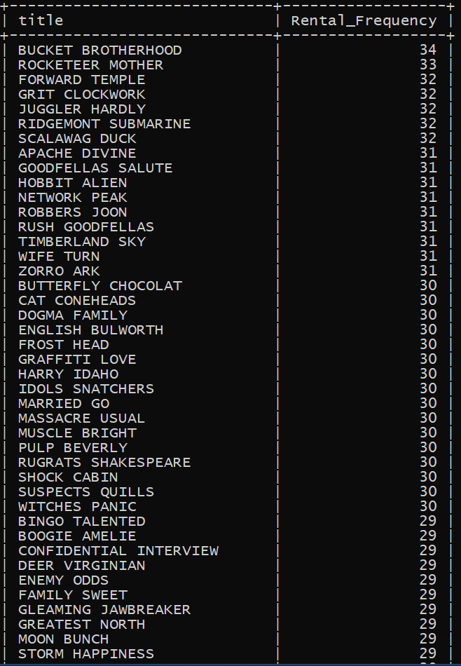
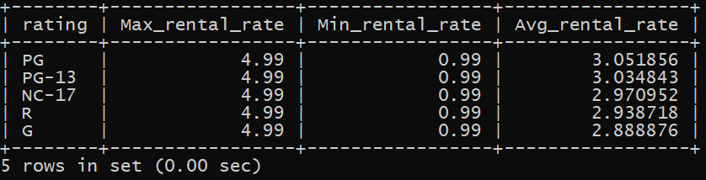
Task 10 Display the maximum, minimum, and average rental rates of movies based on their ratings. The output must be sorted in descending order of the average rental rates. Display the movies in descending order of their rental frequencies, so the management can maintain more copies of those movies.
Query :
select rating, max(rental_rate) Max_rental_rate,min(rental_rate) Min_rental_rate,avg(rental_rate) Avg_rental_rate from film group by rating order by Avg_rental_rate desc;
select title,count(rental_id) Rental_Frequency from film f INNER join inventory i on f.film_id = i.film_id INNER join rental r on r.inventory_id=i.inventory_id group by title order by Rental_Frequency desc;
Conclusion :
Rental rate is highest for PG rating movie.
Bucket Brotherhood is the highest sold movie

Slide 14
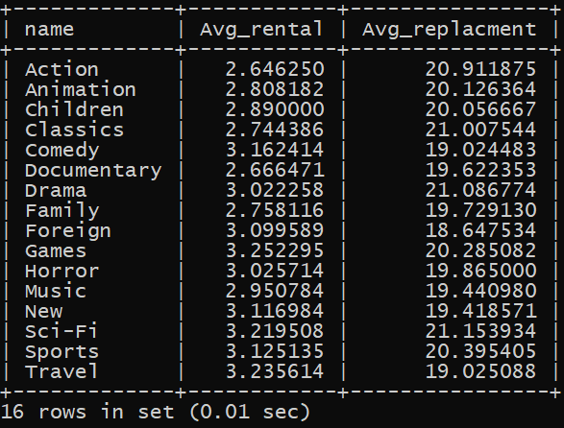
Task 11 In how many film categories, the difference between the average film replacement cost (disc - DVD/Blue Ray) and the average film rental rate is greater than $15? Display the list of all film categories identified above, along with the corresponding average film replacement cost and average film rental rate
Query :
select c.name,avg(rental_rate) Avg_rental, avg(replacement_cost) Avg_replacment from film f inner join film_category fc on f.film_id=fc.film_id inner join category c on fc.category_id=c.category_id group by c.name having (Avg_replacment-Avg_rental)> 15 ;
Conclusion :
SCI_FI has the highest replacement rate

Slide 15
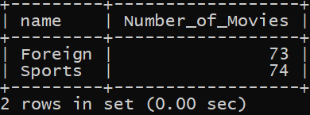
Task 12 Display the film categories in which the number of movies is greater than 70.
Query :
select c.name,count(title) Number_of_Movies from film f inner join film_category fc on f.film_id=fc.film_id inner join category c on fc.category_id=c.category_id group by c.name having Number_of_Movies> 70 ;
Conclusion :
There are only 2 rating has the highest movie

Slide 16

Summary
This all query helps to find the details of the movies which helps to stock up the movies DVD's and blue ray disk in inventory to improve the business.

Slide 17

Thank You

